Slide 1
Case Study: Slope Stabilization for Trunk Highway 2 in Crookston, MN
CEEn 544 – Seepage and Slope Stability
Alex Arndt, Shawn Crawley, Kristin Ulmer

Slide 2
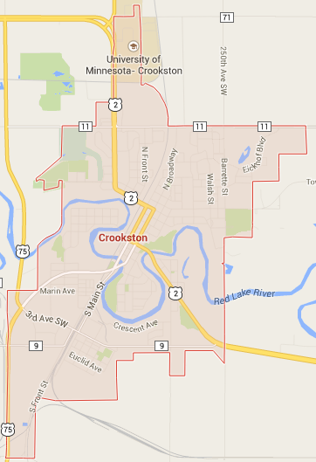
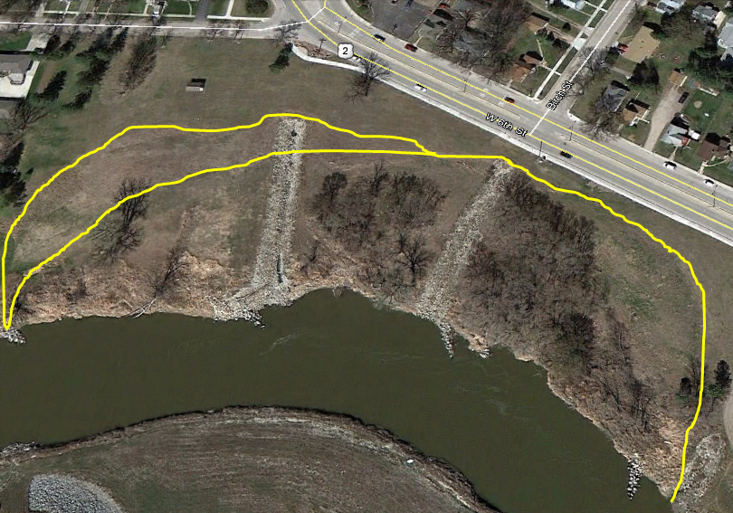
Location of the Slope

Slide 3
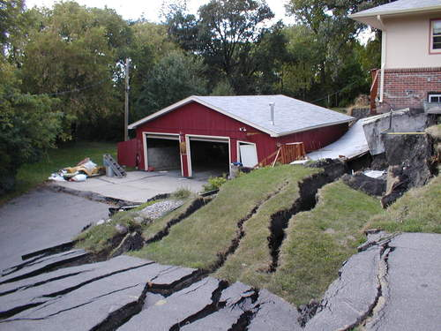
Previous Slope Failures in Crookston
Notes:
House south of TH 2 (September 2003)

Slide 4
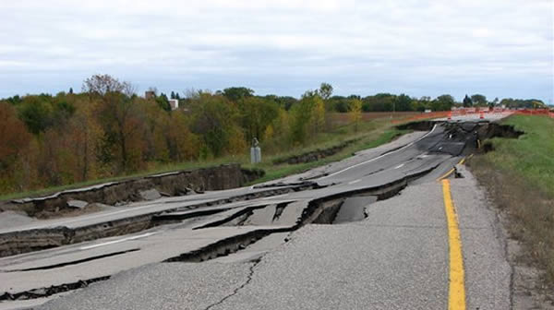
Previous Slope Failures in Crookston
Notes:
Another section of TH2 (2008)

Slide 5
Objectives
Develop appropriate soil parameters and slope geometry cross-sections for use in UTEXAS analysis software
Agree on an appropriate target FS
Identify potential stabilization solutions
Verify that the proposed stabilization solution will achieve the target FS

Slide 6
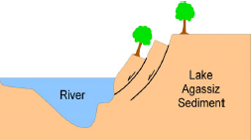
Soil Properties
Ancient Lake Agassiz Sediment
80 ft thick
Very low shear strengths
High clay content
“Huot formation”
Red River eroding the toe of the slope
Incremental slope failures

Slide 7
Soil Properties
Original analysis (2006) performed using these values (modified from triaxial data) -----------------------→
Due to uncertainty, we assigned the Failure Zone (residual) strength as c=0 and φ’=15°

Slide 8
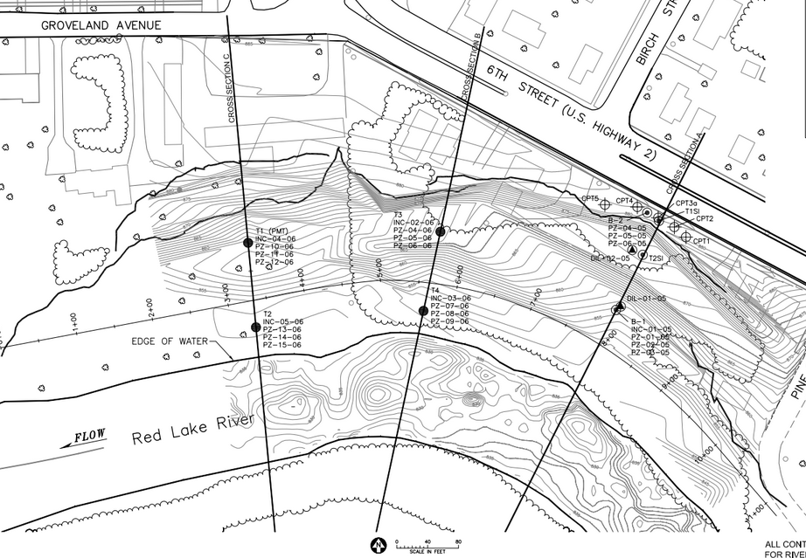
Initial UTEXAS Analysis
Three cross sections (A, B, C) across the site.

Slide 9
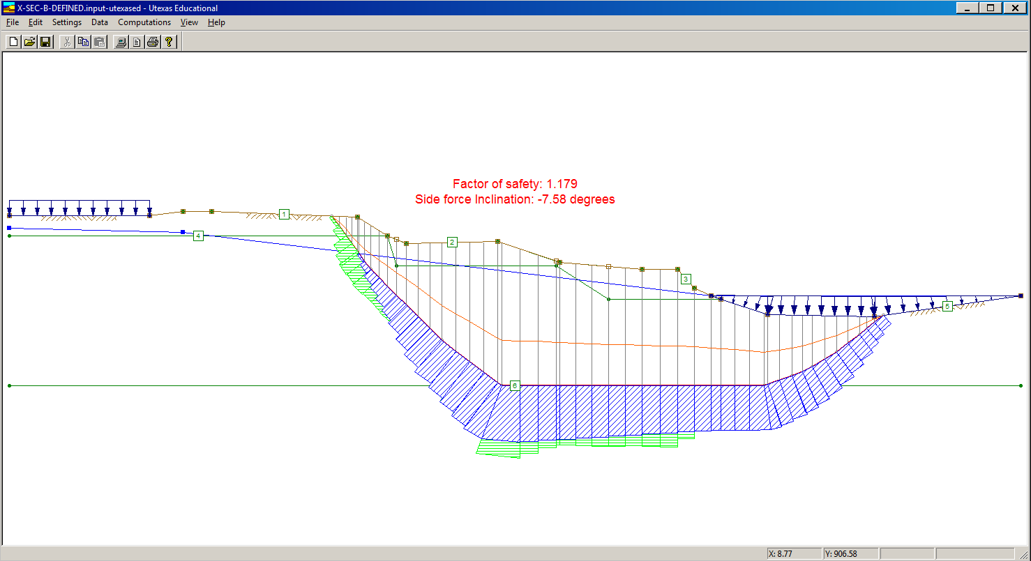
Initial UTEXAS Analysis
Distributed Loads:
Highway (500 psf)
River at the toe
Defined failure surface
Piezometric line

Slide 10
Initial UTEXAS Analysis – factors of safety
Current Conditions
A: 1.11
B: 1.18
C: 1.23
Extreme Conditions
A: 1.06
B: 1.05
C: 1.16

Slide 11
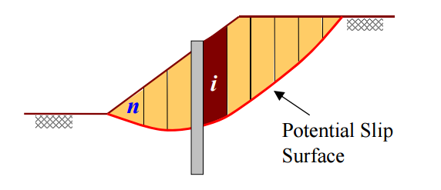
Possible Stabilization Solutions
Slope grading
Physical constraints
May be insufficient in the long term
Driven piles
Vibrations could be problematic
Retaining structure (wall)
Difficult to implement, high cost
Drilled shafts

Slide 12
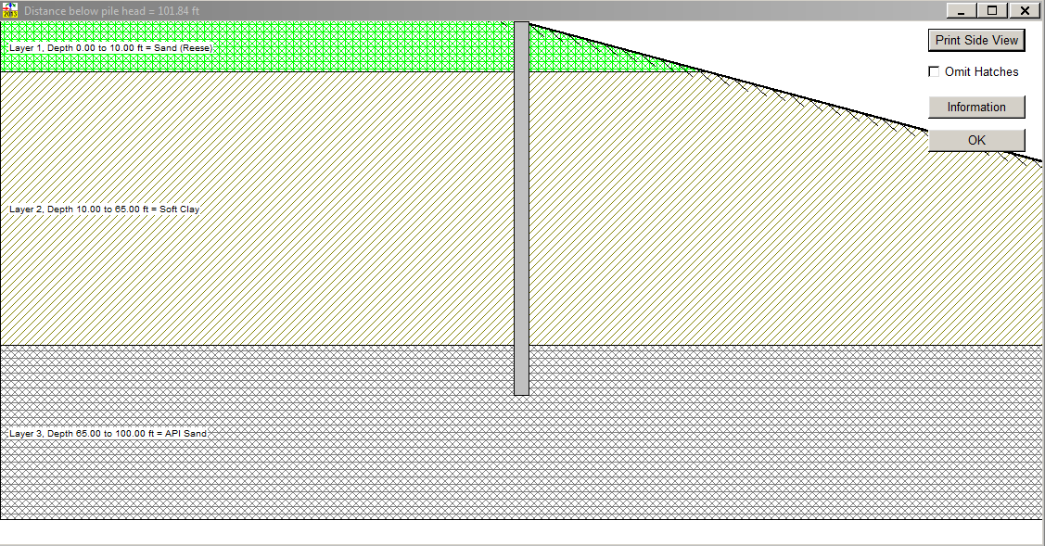
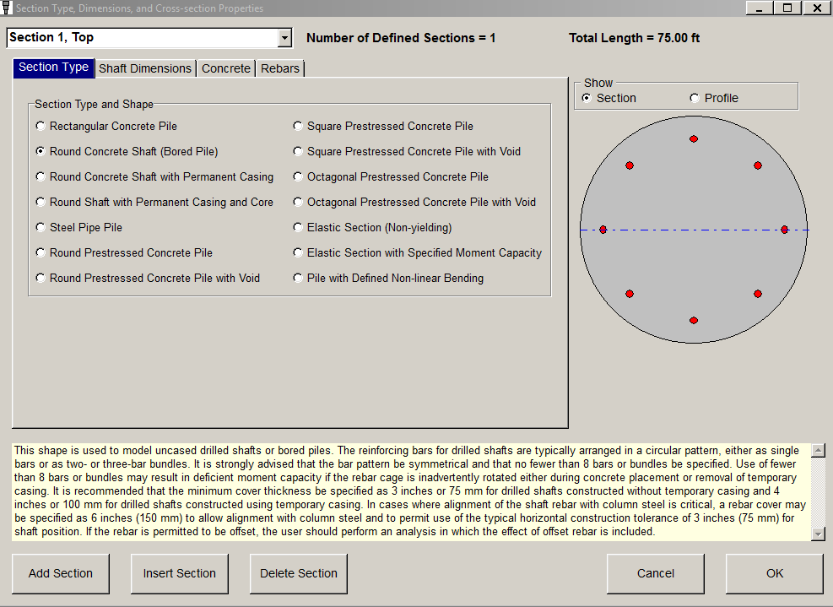
L-Pile Analysis of Drilled Shaft
Assumed amount of displacement
Based on inclinometer data
Maximum displacement = 4 inches
Assumed shaft dimensions
Output: lateral resistance of the shaft

Slide 13
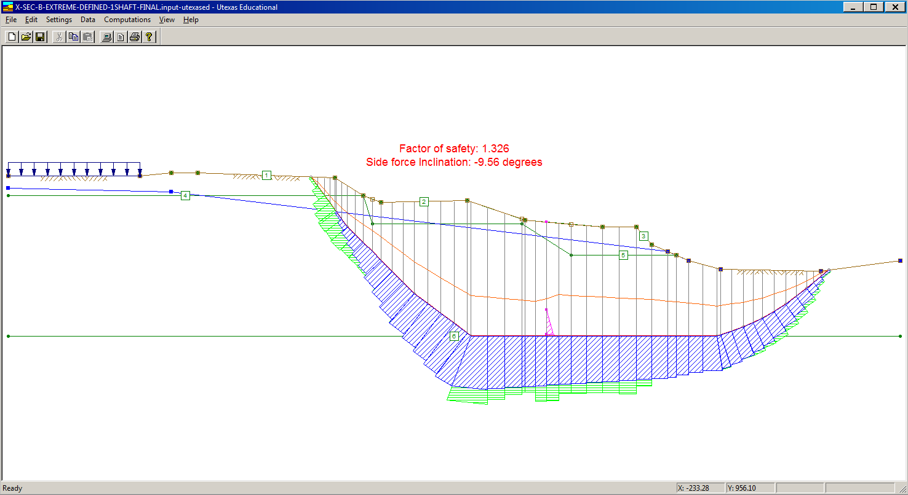
UTEXAS Analysis with Reinforcement
Reinforcement at the failure surface:
A: 100 kip
B: 45 kip
C: 100 kip
Factor of Safety with Reinforcement:
A: 1.47
B: 1.33
C: 1.47

Slide 14
Conclusion
A drilled shaft approach is sufficient to provide a FS = 1.33

